Slide 1

A CRYPTO ACCOUNTING AND PAYMENT SOLUTION FOR NONPROFITS
BixBeta

Slide 2
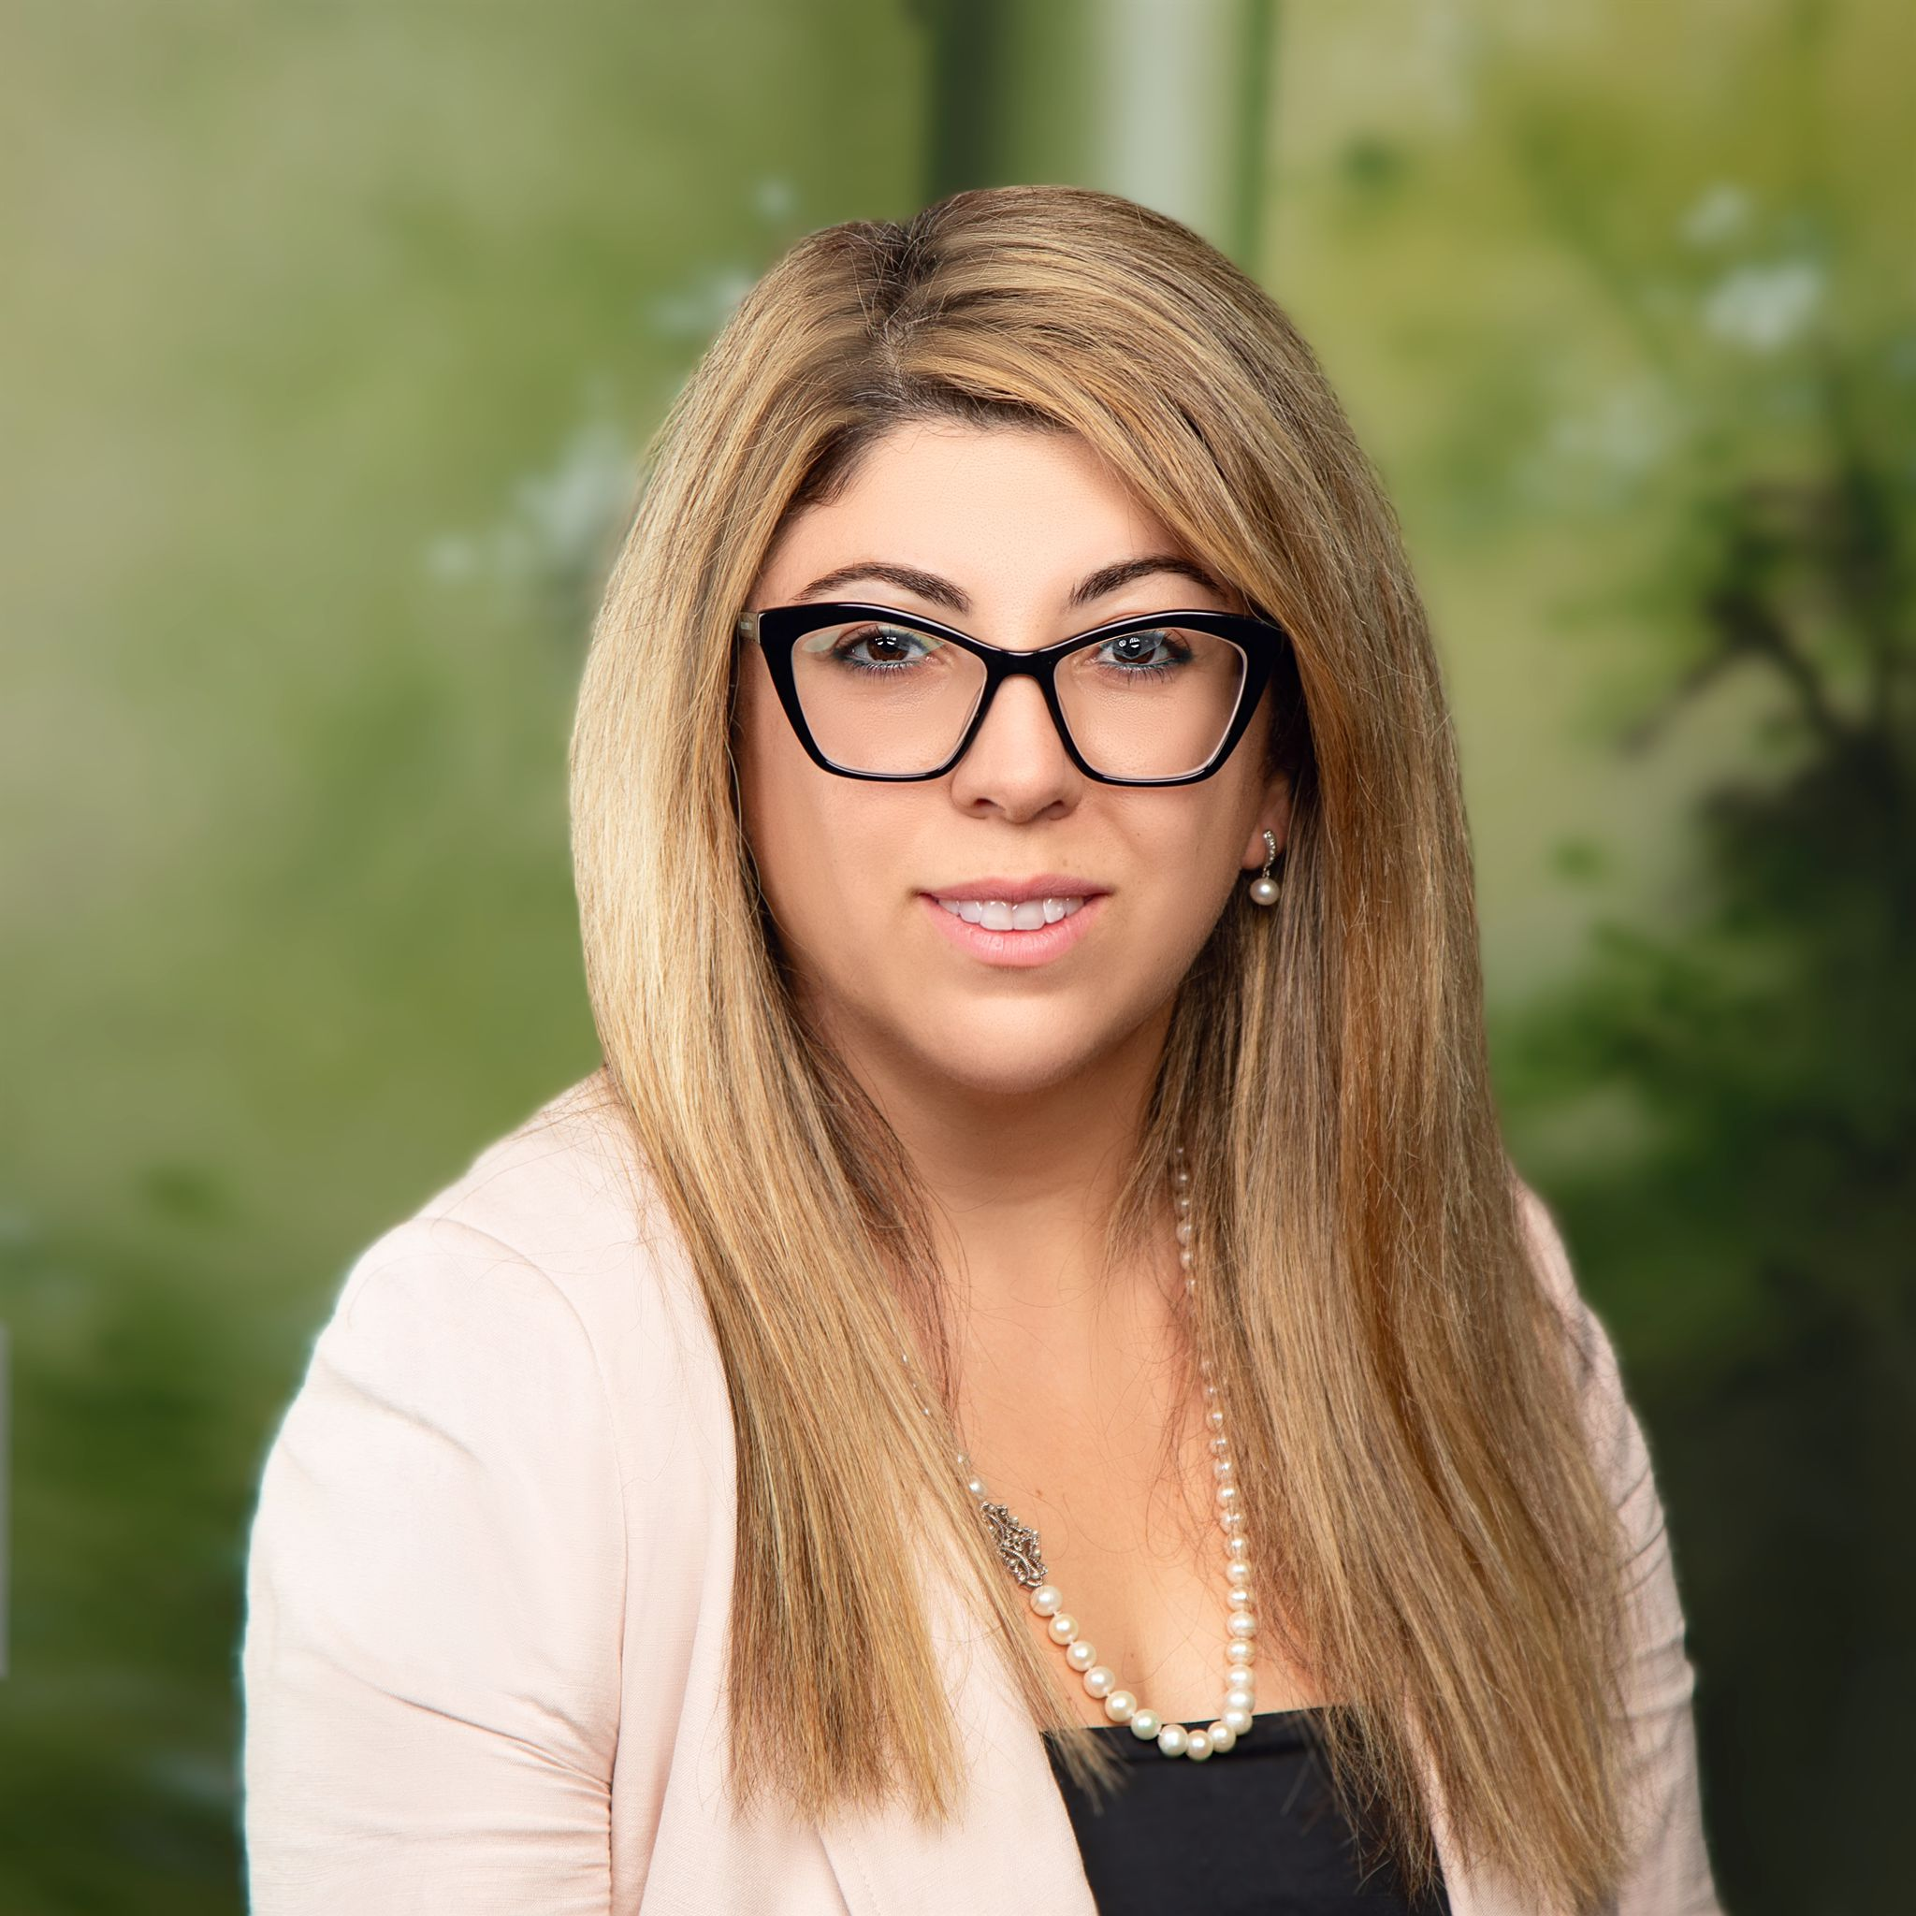









The Founders Are Uniquely Positioned
Kate Koraia, MBA
CEO & Co-founder
Lev Selector, Ph.D.
CTO & Co-founder
Worked with 1000+ nonprofits worldwide for 15+ Years
40 years experience in data science and database management
Implemented 200+ ERP accounting systems and 300+ B2B ledger solutions
Built accounting billing system at AppNexus handling Billions of transactions for 2000 business clients and > $100M per month
Developed and led KPI’s Sage Intact SaaS product line to a 350% YoY growth state
Proven track record of leading data science teams of 20+ people

Slide 3
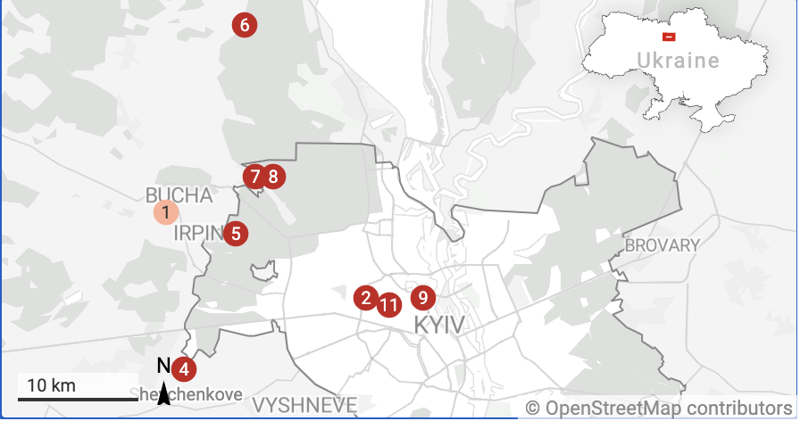
Customer Story
Every year, hundreds of journalists are attacked, imprisoned, or killed. For 40 years, “Customer” has been there to defend them and fight for press freedom
Raised $1,000,000 million in crypto donations
Started accepting crypto donations in November ’21
Utilizing 3rd party vendor to convert crypto to USD
15% of giving revenue came from crypto donations
*The "numbers in red color" represent how many journalists were killed in Ukraine war-zone area in 2022
Notes:
I want to share my customer's real story - NFP's purpose is to protect journalists in war-zone areas and save their lives. Journalists fly to warzone places like Afghanistan and Ukraine in the middle of the war and conflict, dangerous areas. Therefore, I have served nonprofits over the decade because my effort triplicates when I see what they do to save lives and make the world a better place for all of us. This map with red numbers here represents how many journalists have been killed in the Russia-Ukraine war. Sad, unfortunate story, my client fights to protect those journalists in the warzone, so they started accepting crypto donations in Nov’21 and recorded up to $1M crypto donations FY21 and Early spring FY22, which equals almost 15% of regular giving revenue, it came, accepted and let assume saved at minimum five journalists live. It is the real story behind why we want to open new revenue sources for nonprofits to be ready and very comfortable to walk into the digital space and not say “NO” to revenue coming from digital assets because they have not prepared for crypto space and they do not have tools in place to accept, transact, reconcile and report on crypto transactions

Slide 4



Market
99B
14.9B
2.9B
SAM
SOM
TAM
10M Global Nonprofits
X
$9.9K ARPU (Annual)
1.5M US Nonprofits
X
$9.9K ARPU (Annual)
20% BixBeta Market Share
X
$14.9B SAM

Slide 5






Problem
Nonprofits face too many obstacles when accepting crypto donations and have no accounting solution to track, reconcile and report on crypto transactions.
Complicated Set-Up
Crypto Volatility
Expensive Fiat Conversion
Lack of Security & Compliance
Knowledge Barrier
No Accounting Integration

Slide 6

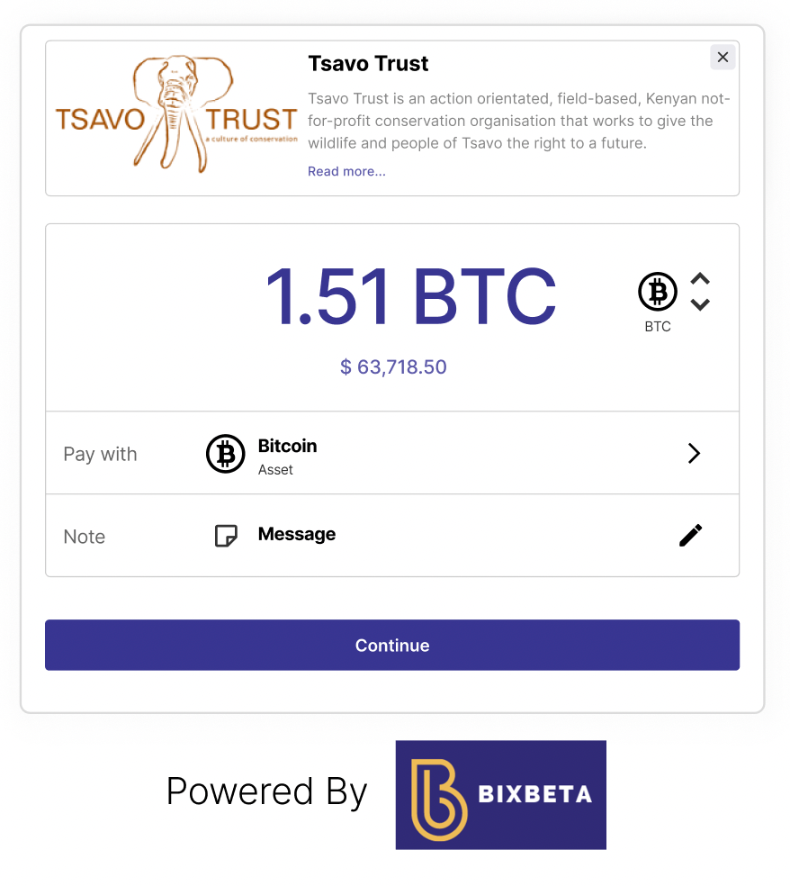


BixBeta is the Solution
The Unified Crypto Accounting and Payment Solution for Nonprofits
1
2
3
4
Pick Your Tool
Receive Donation
Automated Conversion and Bank Deposit
Tax Letter
Generate a crypto donation button or a scannable QR code. Then embed it on your website for easy use.
After following the button or QR-code, users can donate in the crypto of their choice.
BixBeta converts the crypto donation into fiat money and deposits it in nonprofits’ bank account
After the donation, the donor automatically receives a tax acknowledgment letter.

Slide 7
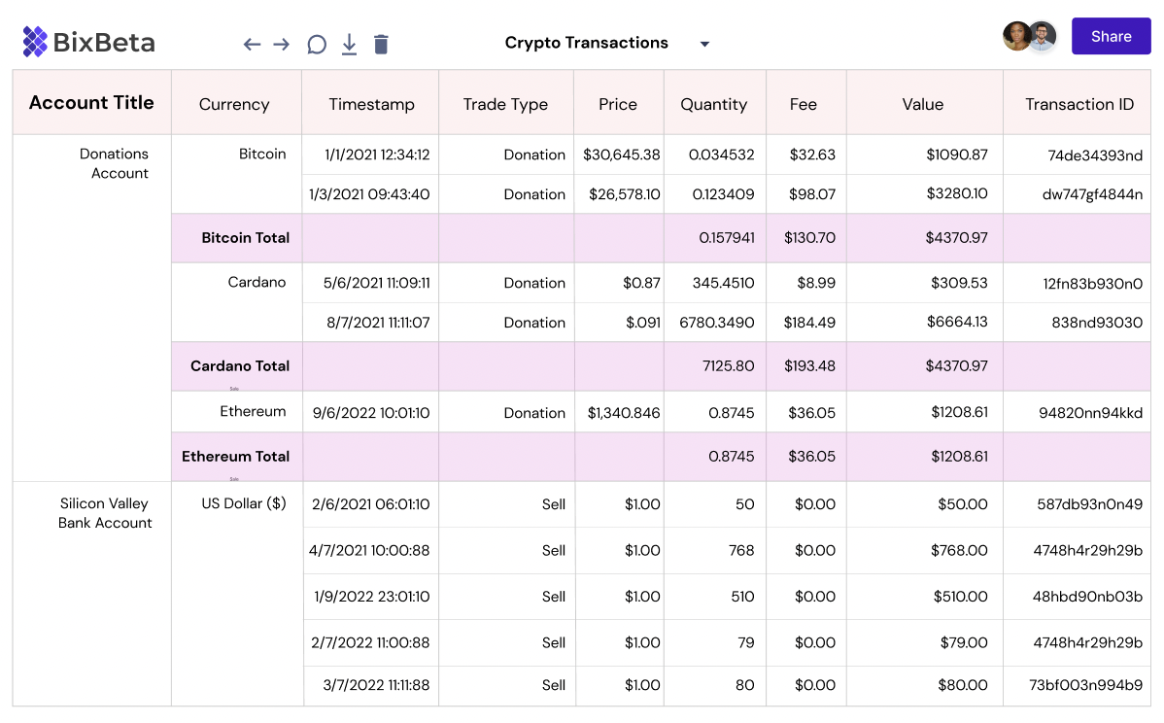



Seamlessly Integrate to Current ERP Accounting Systems
Automation
Secure and automated consolidation on every crypto transaction
Metrics
Discover real-time insights across entities and projects
Cloud
Access any data from anywhere without full cloud and mobile integration

Slide 8











BixBeta - The Blockchain Bridge
BixBeta is uniting the crypto and accounting spaces – possibly facilitating millions of transactions along the way.

Slide 9




Simplifying the Accounting Profession
BixBeta takes over all the transactional, granular accounting aspect of crypto transactions and enables accountants to take on more of an advisory role.
On-Chain Accounting
Client Management
Security & Compliance
Automation
By utilizing the blockchain’s data, we will be able to offer instant transaction settlement and recording.
BixBeta fully manages the manual accounting process for every crypto donation received by a CPA client.
BixBeta allows CPA firms to manage crypto donations for all their clients within one centralized interface.
BixBeta adheres to the highest accounting and security regulations.

Slide 10
Business Model
Base Model
3% + 99Ȼ
Per Crypto Transaction
Subscription Model
$5,500 per year
Transaction discount and extended functionality
Enterprise Model
Custom Contract
Complete product at set service agreements

Slide 11

Path to $100M Revenue by 2028
BixBeta receives $30 for every $1,000 donation
By 2028, there’s an estimated $16B in crypto donations* which equates to $100M in revenue for BixBeta at 20% share*
SaaS revenue adds an additional $2.7M in revenue ($5.5K per nonprofit at 500 nonprofits)
* In 2021, there was $485 Billion donated in USD [Source], and $330 Million was requested to be donated in crypto. [Source: ] The average crypto donations are growing over 1000% from 2020 to 2021. YoY [Source: ]
Notes:
In 2021, Americans gave $484.85 billion to charity, a 4.0% increase over 2020.
Source - https://givingusa.org/wp-content/uploads/2022/06/GivingUSA2022_Infographic.pdf
In 2021 we started to see some of that wealth spread, with over $330 million in crypto donations to nonprofits and charities. That’s a 971% increase from the $28M donated in 2020
Source - https://insidecharity.org/2022/02/14/tosha-anderson-cryptocurrency-for-nonprofits/
The average crypto donations also saw a 236% increase, rising from an average of $3,109 in 2020 to $10,445 in 2021
Source - https://cointelegraph.com/news/crypto-donations-jumped-nearly-16x-in-2021-new-report-says

Slide 12

















Competition
Crypto
Investing
Accounting
Fiat

Slide 13
BixBeta Milestones
Series A - Fall 24’ 70 Active Nonprofit Customers with Revenue Growth of 25%
5
$3M to get to Market Fit & Fraction Ready for Series A
4
Public Beta Fall 23’ 20 high-touch sales by founders' network
3
$3M Seed Round Through Apr 23’ Hire 4 local and remote software engineers to refine BixBeta MVP. See hiring plan
2
Private Beta Spring 23’ Onboard 2 Preselected Design Partners by Spring 2023 and Continue Software Development
1
UI Prototyping and Validation 2021 to Today Ideation and MVP development, UX and clickable UI prototype
Notes:
getting money to achieve goal, not activity
add Value for customers - customers using BB to raise revenue by %, Values, KPIS

Slide 14


Our Vision. Building Blocks
Future Goals
Idea Validation
Business Canvas Model
1st Angel Investor
Onboard two design partners
Full-scale ERP enterprise accounting system for crypto
KPI, BI, and Dashboarding
ESG & donor impact measurement
Other Industry Verticals : RE, etc.
Market Analysis
Tech Blueprint
Customer case study
1st Product Release
Build Advisory Board
Product Prototyping
FT CTO & Cofounder
Seed round fundraising
Nov ‘21: Idea Validation
June ‘22: Incorporation
Oct ‘22: Started MVP Development
Spring ‘23: Product Market Fit
2024: Product Expansion
Notes:
Where did we start?
Idea validation in Nov 21: started idea validation, founded cofounder, advisors, research, learning, customer surveys, market & competitor analysis
June 2022: Incorporation, building technology stack, product market fit, analyze go-to-market strategy, prototyping, financial modelling,
October 2022: first angel investor, customer case study, FT CTO & Cofounder, VP of technology, UI/UX testing, MVP development
Product Validation phase Jan 2023: working MVP with 2 preselected design partners, AICPA startup accelerator selected,
June 2023: reach 2.53M 1st seed fundraising round
October Product Market Fit Phase:
Next Series A:
Scalability: become crypto ERP enterprise accounting system

Slide 15

Thank you!

Slide 16
Appendix

Slide 17






The BixBeta Company Roadmap
Jan 2022
Dec 2022
Started Product Vision
& Market Analysis
Accepted to present Pitch at AICPA Start-up Accelerator Program
Oct 2022
Nov 2021
Received 1st Angel Investment
&
CTO, Co-founder joined company full-time
Our Idea was born
June 2022
Incorporated BixBeta
&
Started design and build of minimum viable product

Slide 18














Tech Stack
AWS: Linux Servers & Storage
Backend Data Integration
Load
Balancer
Data Integration
Account Management
DB Management
Banks
Crypto Wallets
Accounting Systems

Slide 19
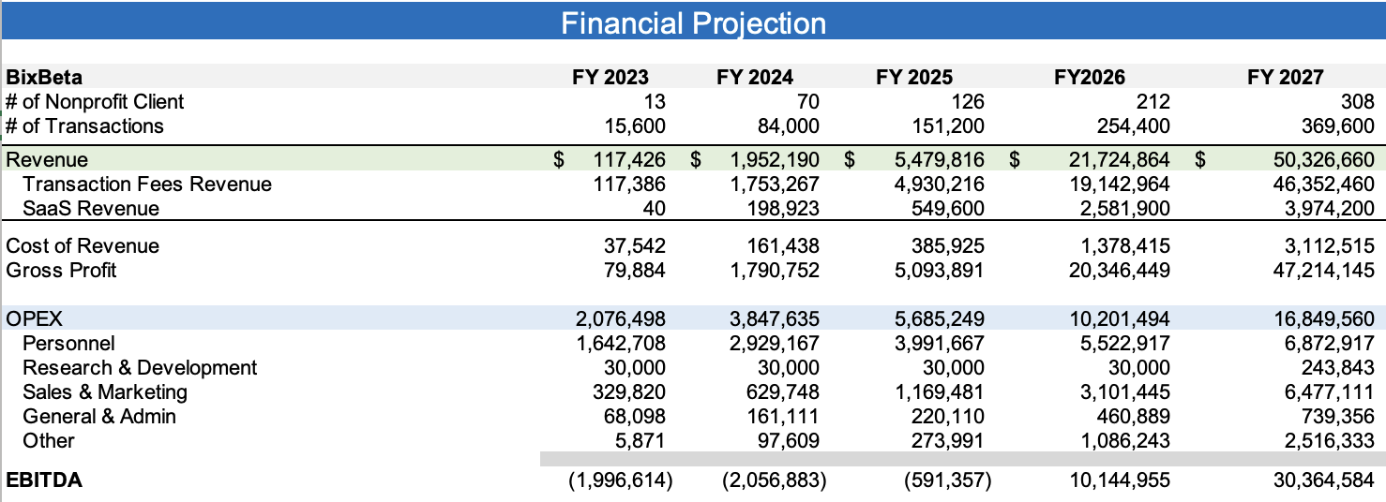
Financials

Slide 20

Vision
Our vision is to empower every business by embracing emerging technologies, such as the blockchain ledger, to provide an increased positive economic and social value to the world.

Slide 21
Mission Statement
Our mission is to create a transparent blockchain and crypto-accessible ecosystem where nonprofits, donors, fundraiser professionals, and accountants will have one single source of truth to share.
Notes:
Thus, we solve a problem from the perspective of:
Crypto Donor – It makes very easy steps to go to a Nonprofit website/receive an email with a QR code, select 75+ approved cryptocurrency, click donate and receive an automatic acknowledgment letter/tax receipt, see real-time impact measurements and KPIs
Nonprofit – New revenue growth source with secure, fast, low-cost, zero risk. Set-up takes < 2hr
Accountant – Integration into the accounting system eliminates tedious and manual work so that accounting staff can focus on the analytical side. Crypto donations, payments, and receipts are converted into USD and are automatically posted and reconciled into the accounting system.
Fundraiser – Trusted community to expand crypto fundraising network

Slide 22






Core Values
Teamwork
Ambition
Boldness
Honesty
Loyalty
Fun

Slide 23

Value Proposition
BixBeta helps nonprofits to increase their revenue and impact by accepting crypto donations. On top of that, we’ve also automated the entire accounting process so nonprofit leaders can focus on the things that truly matter and accountants can take on more of an advisory role.
Notes:
Customer Email with one pager.
Walk them through figma prototype on demo is the end goal.
Want to say in email to us. Yes Kate, we will be more than happy to jump on a call here. Why we are different? We are compared to zen ledger with taxes.
Have accepted donation.
Now accountant goes back to BixBeta. Should have integrations menu button on the left. Make integration setup. With two sub buttons sync setup & sync now.
Client needs to see that they are logged in and they click sync and then they see the transaction synced to Sage Intact.
What would it look like in Sage Intact.
On BixBeta we need to see a menu icon transactions. When they click on this icon, same transactions from accounting slide can be listed here.
Need to do the same for deposits. (Donations without invoice)

Slide 24



How We’ll Win
Strategic Partners
Annual Forecast
2023
2024
2025
2026
2027
See appendix for more details
New Customers
13
63
93
213
393
Key Drivers & Assumptions
Monthly Active Referral Partners
2 -> 100 (scales over 5 years)
Monthly New Leads per Partner
3-> 10 (scales over 5 years)
Customer Conversion Rate
50%

Slide 25
Accounting Access and Integration
Crypto Donations
& Transaction
Donation Management
75+ Crypto Currencies
Fast and Safe Consolidation
Instant Transactions
Metric & Dashboards
Secure & Transparent
Product Vision
Cryptocurrency Transacting & Accounting
Crypto donations are the new status quo in the Nonprofit sector
Easy and Fast Setup
Progress Notifications
Donation Alerts
Track Donation
2-Click Donations
International Support
Usability and Customer Love
Donor Impact Measurement

